Slide 1

FUNDAMENTALS OF SYSTEMS ENGINEERING
IOT
UNIT-13

Slide 2
system
A system is an integrated composite of people, products, and processes that provide a capability to satisfy a stated need or objective.

Slide 3
Fundamental of system engineering
A methodical, multi-disciplinary approach for the design, realization, technical management, operations, and retirement of a system.

Slide 4
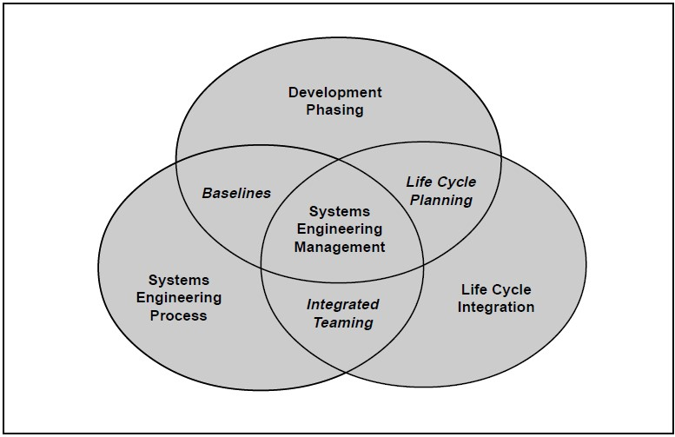
FUNDAMENTAL OF SYSTEMS ENGINEERING

Slide 5
Basic principles
Safety
Functionality
Good design
Innovation
Sustainability

Slide 6
Effectiveness of systems engineering principles in the development
Systems engineering is concerned with combining multiple elements or subsystems, of various physical and logical types, into a best-balanced functional whole to accomplish the mission goals. This principle addresses the system integration aspects of systems engineering.

Slide 7
Effectiveness of systems engineering production and deployment
The primary purpose of the production & deployment phase is to produce a system capability that satisfies a well –defined operational need. In this phase of the acquisition life cycle , formal initial operation test & evaluation is performed to determine system effectiveness and suitability.

Slide 8
Various stages of systems engineering
Problem definition
Selection of goals and criteria
System synthesis
Analysis of alternatives
Refinement of alternatives
Decision making
Planning for action

Slide 9
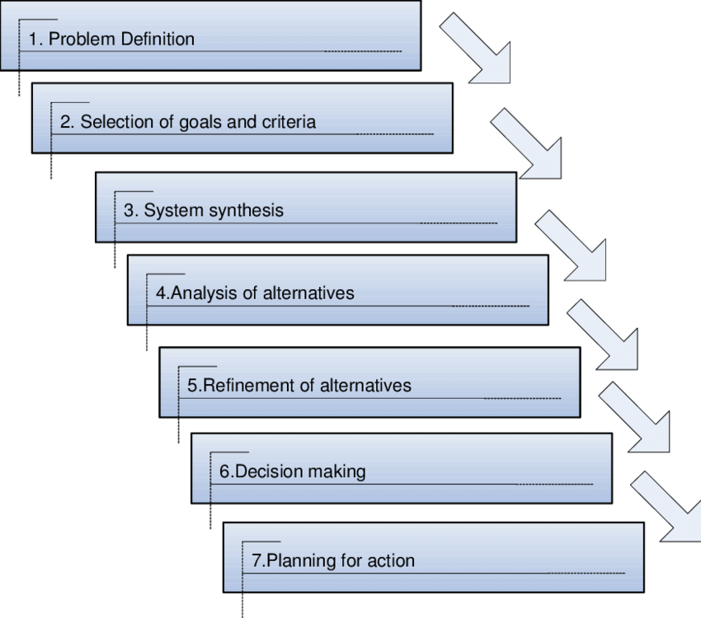
Various stages of systems engineering

Slide 10
Requirements analysis
Requirements analysis or requirements engineering is a process used to determine the needs and expectations of a new product.
It involves frequent communication with the stakeholders and end-users of the product to define expectations, resolve conflicts, and document all the key requirements.

Slide 11
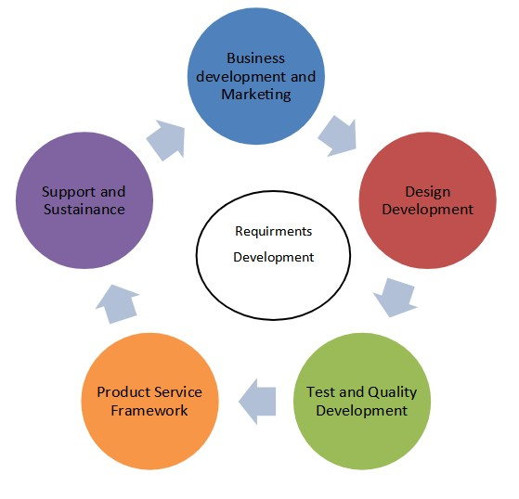
Requirements analysis

Slide 12
system analysis
Systems analysis is “The process of studying a procedure or business to identify its goal and purposes and create systems and procedures that will efficiently achieve them.

Slide 13
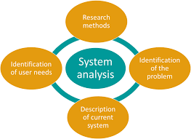
system analysis

Slide 14
Functional analysis
Functional analysis is the systematic process of identifying, describing, and relating the functions a system must perform in.
It an extension of operational studies, directed to establishing whether there is a feasible technical approach to a system that could meet the operational objectives

Slide 15
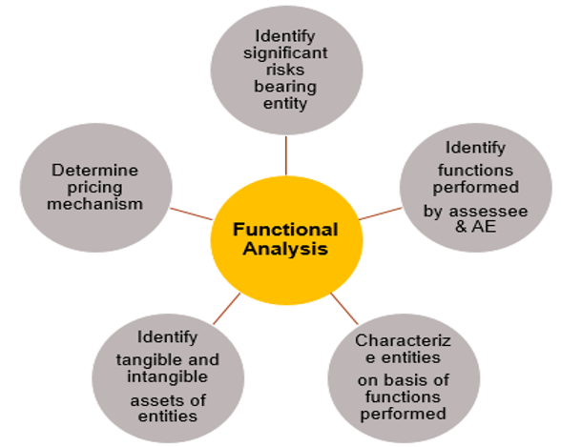
Functional analysis

Slide 16
Design validation
Design validation is a testing process by which you prove (“validate”) that the device you've built works for the end user as intended.
Design validation is “establishing by objective evidence that device specifications conform with user needs and intended use”

Slide 17
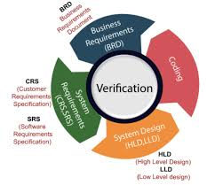
Design validation

Slide 18
Demonstrate
Systems engineering focuses on analyzing and eliciting customer needs and required functionality early in the development cycle, documenting requirements, then proceeding with design synthesis and system validation while considering the complete problem, the system lifecycle.

Slide 19
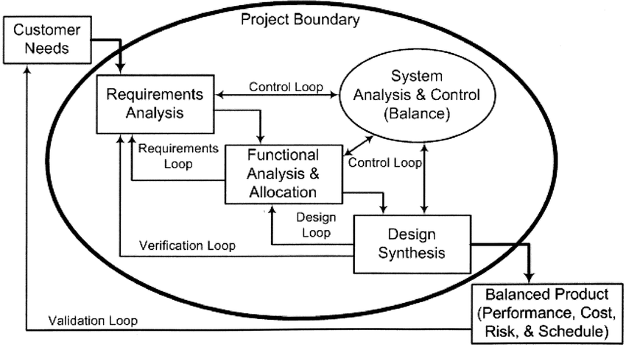
Demonstrate

Slide 20
Thank you…
by
Hemalatha.G

